Slide 1
BLE
Bluetooth Low Energy
BACLE Lucas, ESTIVAL Emilie,
POTIERS Léo, SERONIE-VIVIEN Paul

Slide 2
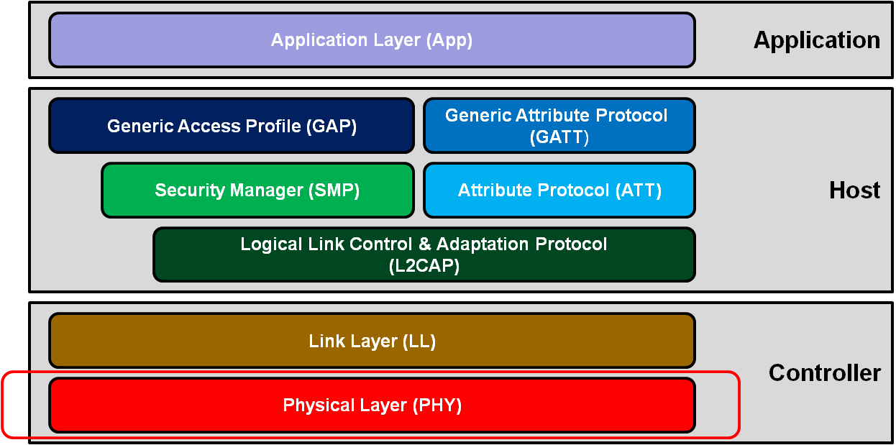
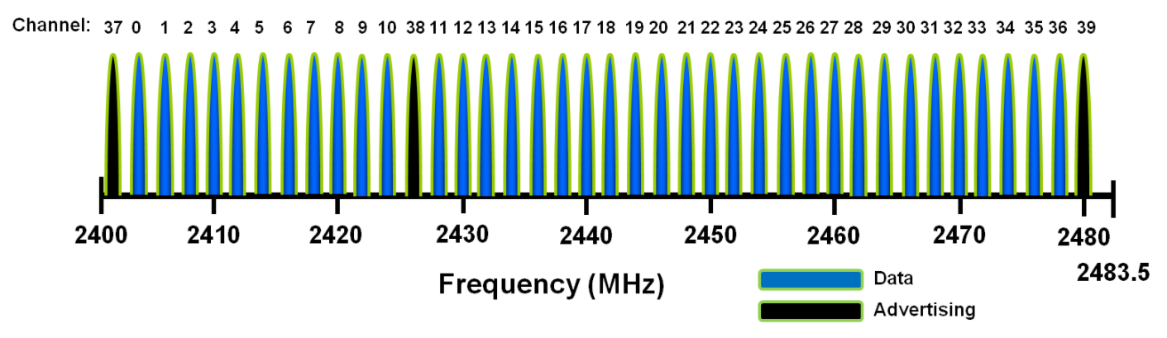
Physical layer
First layer of the protocol stack
2.4GHz range and 40 channels
BLE has 40 different channels that are spaced by 2MHz, either dedicated to data or advertising.
→ Connection is made with channels that are out of the Wi-Fi range
The services provided by this layer go directly to the link layer
→ Link Layer (LL)

Slide 3
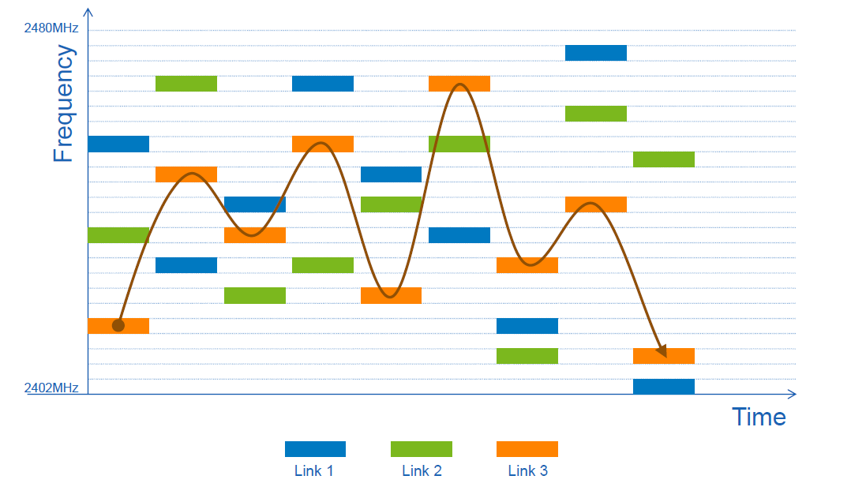
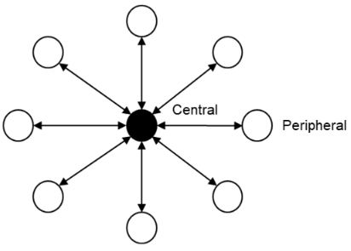
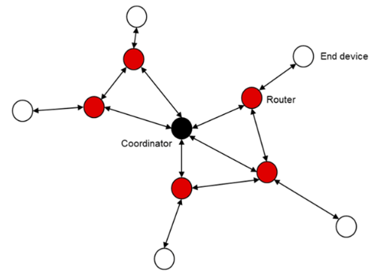
Link layer
Device address
Packets format
Reliability
Encryption
MAC level operations

Slide 4



Power consumption
Low power consumption
Optimizing current consumption
What can affect power consumption in BLE ?
Peak current 2 times lower than Bluetooth Classic
Power consumption 2 to 100 times lower
→ But highly dependent on the use case
Extends battery life and makes better products
Peripherals can function for 1 to 4 years on coin cell battery
→ BLE is designed to enable devices to have very low power consumption
Amount of power transmitted
Total amount of time that the radio is active
→ Highly dependent on the environment and parameters

Slide 5


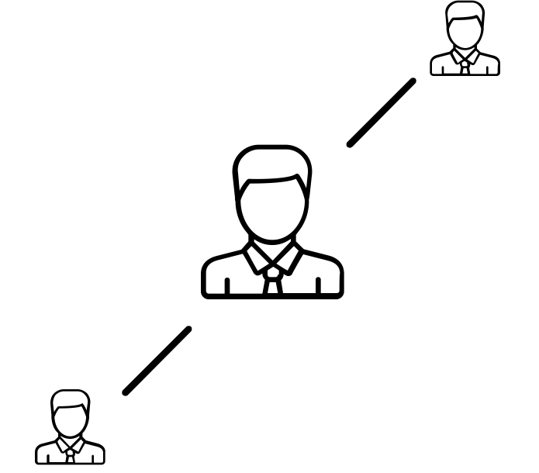
Security
Passive eavesdropping
Men In The Middle (MITM) attacks
Identity tracking
When a third device listens to the data being exchanged between the two paired devices.
→ AES Encryption, but vulnerabilities in the key exchange protocol
When both the central and peripheral devices will connect to the malicious device which redirects the communication route to himself.
→ Data interception and false data injection risk
When a malicious entity is able to associate the address of a BLE device with a specific user and tracks him.
→ Need to change frequently the device connection address (but it is not done efficiently or frequently enough)

Slide 6

Do you have any questions ?

